Slide 1
Chapter 5
Digital Design and Computer Architecture: ARM® Edition
Sarah L. Harris and David Money Harris

Slide 2
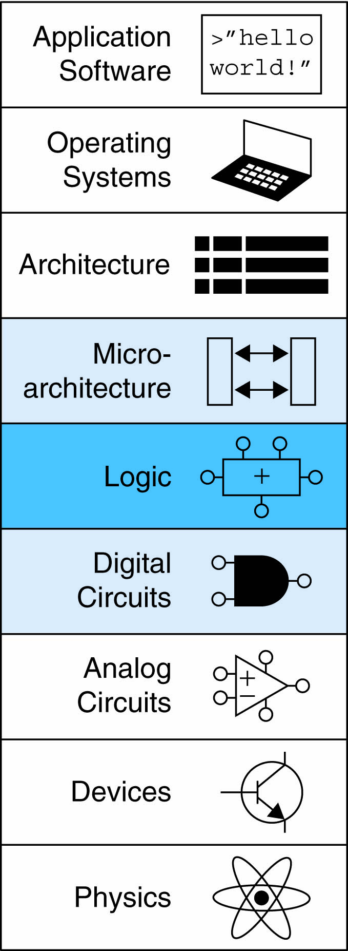
Chapter 5 :: Topics
Introduction
Arithmetic Circuits
Number Systems
Sequential Building Blocks
Memory Arrays
Logic Arrays

Slide 3
Introduction
Digital building blocks:
Gates, multiplexers, decoders, registers, arithmetic circuits, counters, memory arrays, logic arrays
Building blocks demonstrate hierarchy, modularity, and regularity:
Hierarchy of simpler components
Well-defined interfaces and functions
Regular structure easily extends to different sizes
Will use these building blocks in Chapter 7 to build microprocessor

Slide 4
1-Bit Adders

Slide 5
Multibit Adders (CPAs)
Types of carry propagate adders (CPAs):
Ripple-carry (slow)
Carry-lookahead (fast)
Prefix (faster)
Carry-lookahead and prefix adders faster for large adders but require more hardware
Symbol

Slide 6
Ripple-Carry Adder
Chain 1-bit adders together
Carry ripples through entire chain
Disadvantage: slow

Slide 7
Ripple-Carry Adder Delay
t_{ripple} = Nt_{FA}
where t_{FA} is the delay of a 1-bit full adder

Slide 8
Carry-Lookahead Adder
Compute C_{out} for k-bit blocks using generate and propagate signals
Some definitions:
Column i produces a carry out by either generating a carry out or propagating a carry in to the carry out
Generate (G_{i}) and propagate (P_{i}) signals for each column:
Generate: Column i will generate a carry out if A_{i} and B_{i} are both 1.
G_{i} = A_{i} B_{i}
Propagate: Column i will propagate a carry in to the carry out if A_{i} or B_{i} is 1.
P_{i} = A_{i} + B_{i}
Carry out: The carry out of column i (C_{i}) is:
C_{i} = A_{i} B_{i} + (A_{i} + B_{i} )C_{i-1} = G_{i} + P_{i} C_{i-1}

Slide 9
Block Propagate and Generate
Now use column Propagate and Generate signals to compute Block Propagate and Generate signals for k-bit blocks, i.e.:
Compute if a k-bit group will propagate a carry in (to the block) to the carry out (of the block)
Compute if a k-bit group will generate a carry out (of the block)

Slide 10
Block Propagate and Generate Signals
Example: Block propagate and generate signals for 4-bit blocks (P_{3:0} and G_{3:0}):
P_{3:0} = P₃P₂ P₁P₀
G_{3:0} = G₃ + G₂P₃ + G₁P₂P₃ + G₀P₁P₂P₃
= G₃ + P₃ (G₂ + P₂ (G₁ + P₁G₀ )

Slide 11
Block Propagate and Generate Signals
In general for a block spanning bits i through j,
P_{i:j} = P_{i}P_{i-1} P_{i-2 …} P_{j}
G_{i:j} = G_{i} + P_{i} (G_{i-1} + P_{i-1} (G_{i-2} + P_{i-2 …} G_{j} )
C_{i} = G_{i:j} + P_{i:j} C_{j-1}

Slide 12
32-bit CLA with 4-bit Blocks

Slide 13
Carry-Lookahead Addition
Step 1: Compute G_{i} and P_{i} for all columns
Step 2: Compute G and P for k-bit blocks
Step 3: C_{in} propagates through each k-bit propagate/generate logic (meanwhile computing sums)
Step 4: Compute sum for most significant k-bit block

Slide 14
Carry-Lookahead Addition
Step 1: Compute G_{i} and P_{i} for all columns
G_{i} = A_{i} B_{i}
P_{i} = A_{i} + B_{i}

Slide 15
Carry-Lookahead Addition
Step 1: Compute G_{i} and P_{i} for all columns
Step 2: Compute G and P for k-bit blocks
P_{3:0} = P₃P₂ P₁P₀
G_{3:0} = G₃ + P₃ (G₂ + P₂ (G₁ + P₁G₀ )

Slide 16
Carry-Lookahead Addition
Step 1: Compute G_{i} and P_{i} for all columns
Step 2: Compute G and P for k-bit blocks
Step 3: C_{in} propagates through each k-bit propagate/generate logic (meanwhile computing sums)
B
31:28
A
31:28
B
27:24
A
27:24
B
7:4
A
7:4
B
3:0
A
3:0
C
4-bit CLA
C
27
4-bit CLA
C
23
C
7
4-bit CLA
C
3
4-bit CLA
C
out
Block
Block
Block
Block
in
S
31:28
S
27:24
S
7:4
S
3:0
B
3
+
A
3
C
2
B
2
+
A
2
C
1
B
1
+
A
1
C
0
B
0
+
A
0
C
in
G
S
3
S
2
S
1
S
0
G
B
3
A
3
C
2
B
2
A
2
C
1
B
1
A
1
C
0
B
0
A
0
C
3:0
P
3
+
+
+
+
in
B
A
B
A
B
A
B
A
G
3
S
S
S
S
3
3
2
2
1
1
0
0
P
2
3
2
1
0
C
2
C
1
C
0
C
G
2
G
+
+
+
+
in
P
1
3:0
G
3
G
1
P
3
S
3
S
2
S
1
S
0
B
A
B
A
B
A
B
A
0
G
2
3
3
2
2
1
1
0
0
P
2
G
3:0
G
C
2
C
1
C
0
P
P
3
G
1
P
3
+
+
+
+
C
in
C
out
3:0
P
2
P
1
G
3
C
P
1
G
0
P
2
S
3
S
2
S
1
S
0
in
P
0
G
2
P
P
1
G
G
C
P
3:0
P
3
G
1
3:0
P
3
out
C
P
2
0
G
3
in
P
1
P
2
0
C
P
P
3
G
2
out
3:0
P
2
P
1
C
P
1
G
1
in
P
0
P
0
C
out
P
3:0
P
3
C
P
2
in
P
1
0

Slide 17
Carry-Lookahead Addition
Step 1: Compute G_{i} and P_{i} for all columns
Step 2: Compute G and P for k-bit blocks
Step 3: C_{in} propagates through each k-bit propagate/generate logic (meanwhile computing sums)
Step 4: Compute sum for most significant k-bit block
B
3
+
A
3
C
2
B
2
+
A
2
C
1
B
1
+
A
1
C
0
B
0
+
A
0
C
in
G
S
3
S
2
S
1
S
0
G
B
3
A
3
C
2
B
2
A
2
C
1
B
1
A
1
C
0
B
0
A
0
C
3:0
P
3
+
+
+
+
in
B
A
B
A
B
A
B
A
G
3
S
S
S
S
3
3
2
2
1
1
0
0
P
2
3
2
1
0
C
2
C
1
C
0
C
G
2
G
+
+
+
+
in
P
1
3:0
G
3
G
1
P
3
S
3
S
2
S
1
S
0
B
A
B
A
B
A
B
A
0
G
2
3
3
2
2
1
1
0
0
P
2
G
3:0
G
C
2
C
1
C
0
P
P
3
G
1
P
3
+
+
+
+
C
in
C
out
3:0
P
2
P
1
G
3
C
P
1
G
0
P
2
S
3
S
2
S
1
S
0
in
P
0
G
2
P
P
1
G
G
C
P
3:0
P
3
G
1
3:0
P
3
out
C
P
2
0
G
3
in
P
1
P
2
0
C
P
P
3
G
2
out
3:0
P
2
P
1
C
P
1
G
1
in
P
0
P
0
C
out
P
3:0
P
3
C
P
2
in
P
1
0

Slide 18
Carry-Lookahead Adder Delay
For N-bit CLA with k-bit blocks:
t_{CLA} = t_{pg} + t_{pg_block} + (N/k – 1)t_{AND_OR} + kt_{FA}
t_{pg} : delay to generate all P_{i}, G_{i}
t_{pg_block} : delay to generate all P_{i:j}, G_{i:j}
t_{AND_OR} : delay from C_{in} to C_{out} of final AND/OR gate in k-bit CLA block
An N-bit carry-lookahead adder is generally much faster than a ripple-carry adder for N > 16

Slide 19
Prefix Adder
Computes carry in (C_{i-1}) for each column, then computes sum:
S_{i} = (A_{i} ^ B_{i}) ⊥ C_{i-1}
Computes G and P for 1-, 2-, 4-, 8-bit blocks, etc. until all G_{i} (carry in) known
log₂N stages

Slide 20
Prefix Adder
Carry in either generated in a column or propagated from a previous column.
Column -1 holds C_{in}, so
G₋₁ = C_{in}
Carry in to column i = carry out of column i-1:
C_{i-1} = G_{i-1:-1}
G_{i-1:-1}: generate signal spanning columns i-1 to -1
Sum equation:
S_{i} = (A_{i} ⊥ B_{i}) ⊥ G_{i-1:-1}
Goal: Quickly compute G_{0:-1}, G_{1:-1}, G_{2:-1}, G_{3:-1}, G_{4:-1}, G_{5:-1}, … (called prefixes) (= C₀, C₁, C₂, C₃, C₄, C₅, …)

Slide 21
Prefix Adder
Generate and propagate signals for a block spanning bits i:j
G_{i:j} = G_{i:k} + P_{i:k} G_{k-1:j}
P_{i:j} = P_{i:k}P_{k-1:j}
In words:
Generate: block i:j will generate a carry if:
upper part (i:k) generates a carry or
upper part (i:k) propagates a carry generated in lower part (k-1:j)
Propagate: block i:j will propagate a carry if both the upper and lower parts propagate the carry

Slide 22
16-Bit Prefix Adder Schematic
A
i
B
i
15
14
13
12
11
10
9
8
7
6
5
4
3
2
1
0
-1
i
P
i:i
G
i:i
14:13
12:11
10:9
8:7
6:5
4:3
2:1
0:-1
P
i:k
P
k-1:j
G
i:k
G
k-1:j
14:11
13:11
10:7
9:7
6:3
5:3
2:-1
1:-1
i:j
14:7
13:7
12:7
11:7
6:-1
5:-1
4:-1
3:-1
P
G
i:j
i:j
14:-1
13:-1
12:-1
11:-1
10:-1
9:-1
8:-1
7:-1
G
i-1:-1
A
i
B
i
15
14
13
12
11
10
9
8
7
6
5
4
3
2
1
0
i
S
i

Slide 23
Prefix Adder Delay
t_{PA} = t_{pg} + log₂N(t_{pg_prefix} ) + t_{XOR}
t_{pg}: delay to produce P_{i}, G_{i} (AND or OR gate)
t_{pg_prefix}: delay of black prefix cell (AND-OR gate)

Slide 24
Adder Delay Comparisons
Compare delay of: 32-bit ripple-carry, CLA, and prefix adders
CLA has 4-bit blocks
2-input gate delay = 10 ps; full adder delay = 30 ps
t_{ripple} = Nt_{FA} = 32(30 ps)
= 960 ps
t_{CLA} = t_{pg} + t_{pg_block} + (N/k – 1)t_{AND_OR} + kt_{FA}
= [10 + 60 + (7)20 + 4(30)] ps
= 330 ps
t_{PA} = t_{pg} + log₂N(t_{pg_prefix} ) + t_{XOR}
= [10 + log₂32(20) + 10] ps
= 120 ps

Slide 25
Subtracter

Slide 26
Comparator: Equality

Slide 27
Comparator: Less Than

Slide 28
ALU: Arithmetic Logic Unit
ALU should perform:
Addition
Subtraction
AND
OR

Slide 29
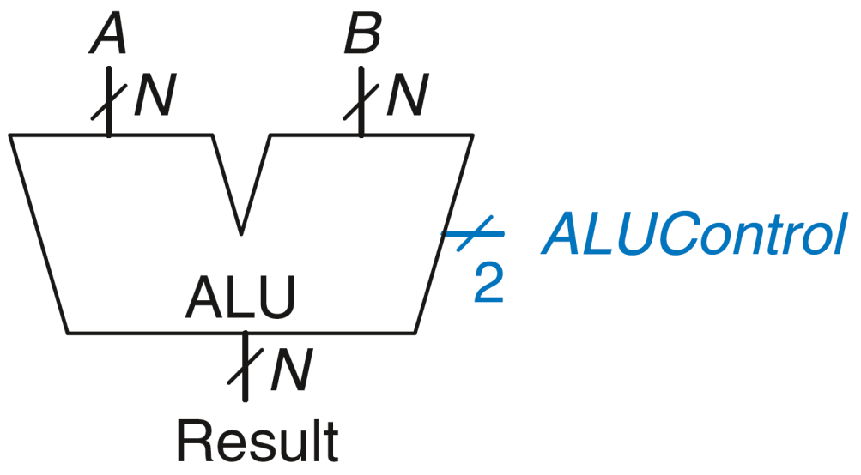
ALU: Arithmetic Logic Unit
ALUControl_{1:0} | Function
00 | Add
01 | Subtract
10 | AND
11 | OR
Example: Perform A + B
ALUControl = 00
Result = A + B

Slide 30
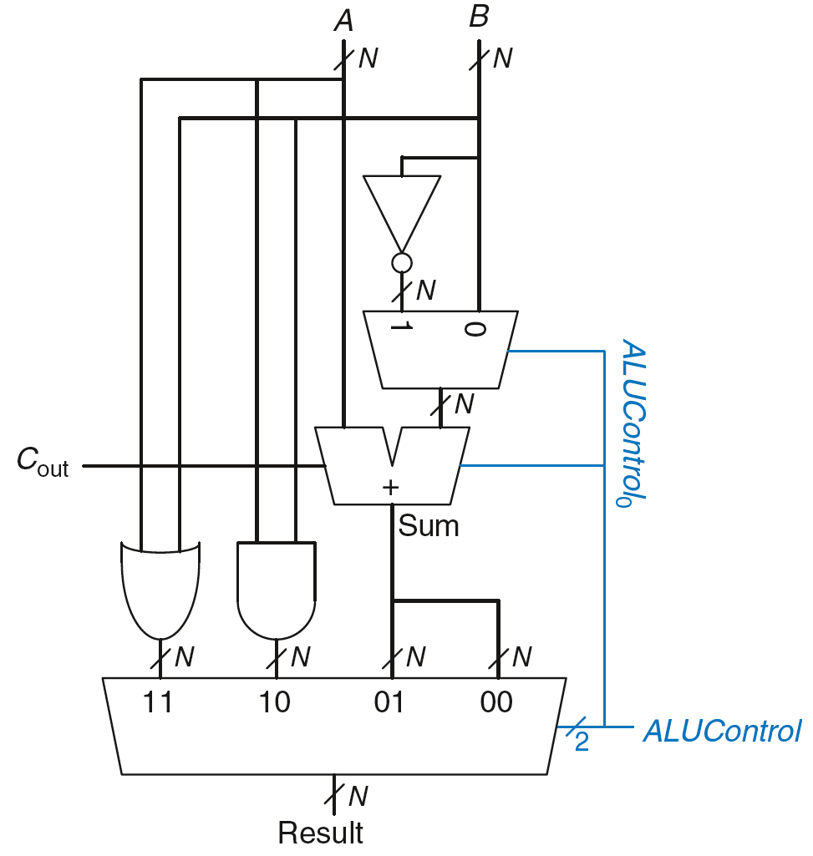
ALU: Arithmetic Logic Unit
ALUControl_{1:0} | Function
00 | Add
01 | Subtract
10 | AND
11 | OR
Example: Perform A OR B

Slide 31
ALU: Arithmetic Logic Unit
ALUControl_{1:0} | Function
00 | Add
01 | Subtract
10 | AND
11 | OR
Example: Perform A OR B
ALUControl_{1:0} = 11
Mux selects output of OR gate as Result, so
Result = A OR B

Slide 32
ALU: Arithmetic Logic Unit
ALUControl_{1:0} | Function
00 | Add
01 | Subtract
10 | AND
11 | OR
Example: Perform A + B

Slide 33
ALU: Arithmetic Logic Unit
ALUControl_{1:0} | Function
00 | Add
01 | Subtract
10 | AND
11 | OR
Example: Perform A + B
ALUControl_{1:0} = 00
ALUControl₀ = 0, so:
C_{in} to adder = 0
2nd input to adder is B
Mux selects Sum as Result, so
Result = A + B

Slide 34
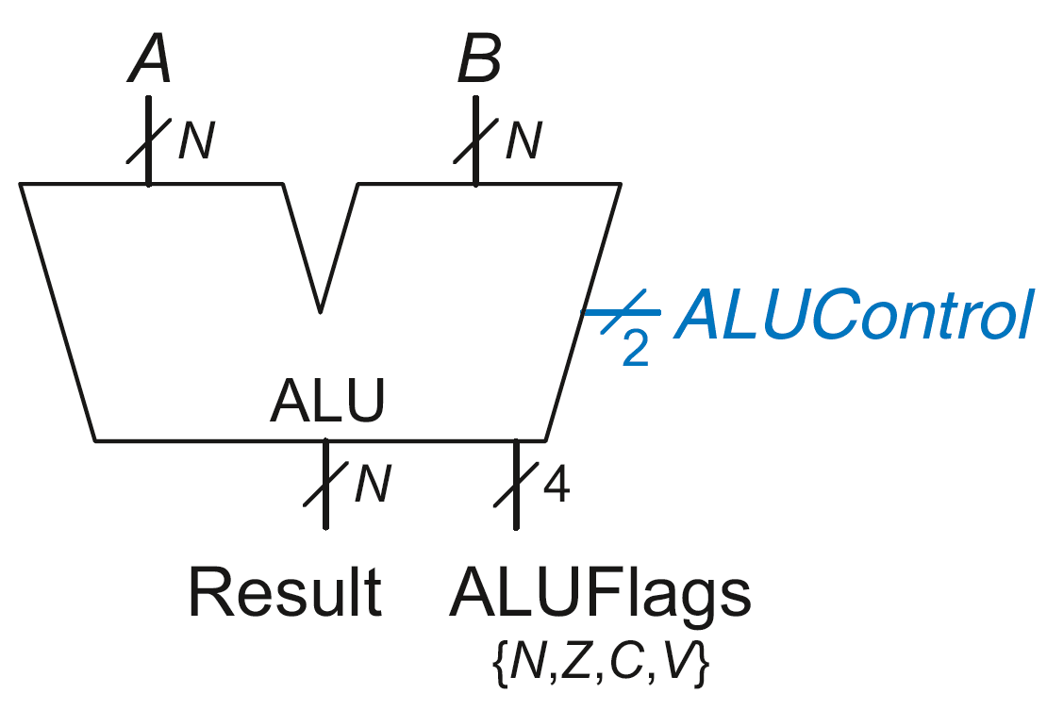
ALU with Status Flags
Flag | Description
N | Result is Negative
Z | Result is Zero
C | Adder produces Carry out
V | Adder oVerflowed

Slide 35
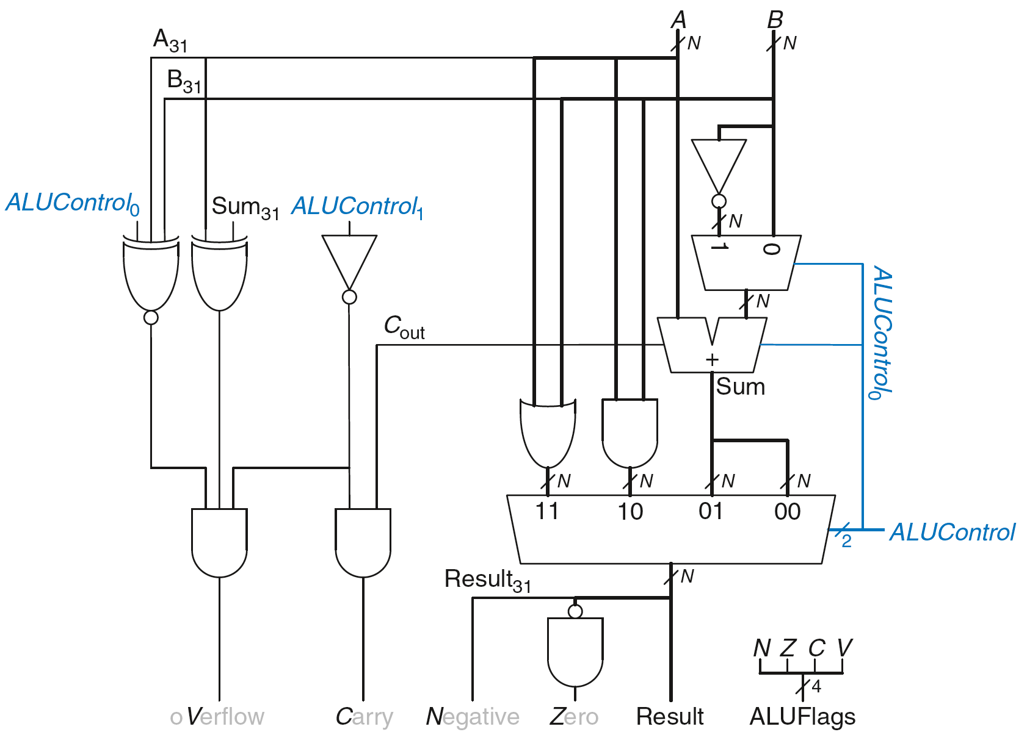
ALU with Status Flags

Slide 36
ALU with Status Flags: Negative
N = 1 if:
Result is negative
So, N is connected to most significant bit of Result

Slide 37
ALU with Status Flags: Zero
Z = 1 if:
all of the bits of Result are 0

Slide 38
ALU with Status Flags: Carry
C = 1 if:
C_{out} of Adder is 1
AND
ALU is adding or subtracting (ALUControl is 00 or 01)

Slide 39
ALU with Status Flags: oVerflow
V = 1 if:
The addition of 2 same-signed numbers produces a result with the opposite sign

Slide 40
ALU with Status Flags: oVerflow
V = 1 if:
ALU is performing addition or subtraction
(ALUControl₁ = 0)

Slide 41
ALU with Status Flags: oVerflow
V = 1 if:
ALU is performing addition or subtraction
(ALUControl₁ = 0)
AND
A and Sum have opposite signs

Slide 42
ALU with Status Flags: oVerflow
V = 1 if:
ALU is performing addition or subtraction
(ALUControl₁ = 0)
AND
A and Sum have opposite signs
AND
A and B have same signs upon addition OR
A and B have different signs upon subtraction

Slide 43
ALU with Status Flags: oVerflow
V = 1 if:
ALU is performing addition or subtraction
(ALUControl₁ = 0)
AND
A and Sum have opposite signs
AND
A and B have same signs upon addition (ALUControl₀ = 0) OR
A and B have different signs upon subtraction
(ALUControl₀ = 1)

Slide 44
Combinational Building Blocks
Multiplexers
Decoders

Slide 45
Multiplexer (Mux)
Selects between one of N inputs to connect to output
log₂N-bit select input – control input
Example: 2:1 Mux

Slide 46
Multiplexer Implementations
Logic gates
Sum-of-products form
Tristates
For an N-input mux, use N tristates
Turn on exactly one to select the appropriate input

Slide 47
Logic using Multiplexers
Using mux as a lookup table

Slide 48
Logic using Multiplexers
Reducing the size of the mux

Slide 49
Logic using Multiplexers
Reducing the size of the mux

Slide 50
Logic using Multiplexers
Reducing the size of the mux

Slide 51
Logic using Multiplexers
Reducing the size of the mux

Slide 52
Decoders
N inputs, 2^{N} outputs
One-hot outputs: only one output HIGH at once

Slide 53
Decoder Implementation

Slide 54
Logic Using Decoders
OR minterms

Slide 55
Shifters
Logical shifter: shifts value to left or right and fills empty spaces with 0’s
Ex: 11001 >> 2 = 00110
Ex: 11001 << 2 = 00100
Arithmetic shifter: same as logical shifter, but on right shift, fills empty spaces with the old most significant bit (msb)
Ex: 11001 >>> 2 = 11110
Ex: 11001 <<< 2 = 00100
Rotator: rotates bits in a circle, such that bits shifted off one end are shifted into the other end
Ex: 11001 ROR 2 = 01110
Ex: 11001 ROL 2 = 00111

Slide 56
Shifter Design

Slide 57
Shifter Design
= A₃
= A₂
= A₁
= A₀

Slide 58
Shifter Design
= 0
= A₃
= A₂
= A₁

Slide 59
Shifter Design
= 0
= 0
= A₃
= A₂

Slide 60
Shifter Design
= 0
= 0
= 0
= A₃

Slide 61
Shifters as Multipliers, Dividers
A << N = A × 2^{N}
Example: 00001 << 2 = 00100 (1 × 2² = 4)
Example: 11101 << 2 = 10100 (-3 × 2² = -12)
A >>> N = A ÷ 2^{N}
Example: 01000 >>> 2 = 00010 (8 ÷ 2² = 2)
Example: 10000 >>> 2 = 11100 (-16 ÷ 2² = -4)

Slide 62
Multipliers
Partial products formed by multiplying a single digit of the multiplier with multiplicand
Shifted partial products summed to form result

Slide 63
Multipliers
Partial products formed by multiplying a single digit of the multiplier with multiplicand
Shifted partial products summed to form result

Slide 64
Multipliers
Partial products formed by multiplying a single digit of the multiplier with multiplicand
Shifted partial products summed to form result

Slide 65
Multipliers
Partial products formed by multiplying a single digit of the multiplier with multiplicand
Shifted partial products summed to form result

Slide 66
Multipliers
Partial products formed by multiplying a single digit of the multiplier with multiplicand
Shifted partial products summed to form result

Slide 67
4 x 4 Multiplier

Slide 68


4 x 4 Multiplier

Slide 69


4 x 4 Multiplier

Slide 70



4 x 4 Multiplier

Slide 71

4 x 4 Multiplier

Slide 72
Dividers
A/B = Q + R/B
Decimal Example: 2584/15 = 172 R4

Slide 73
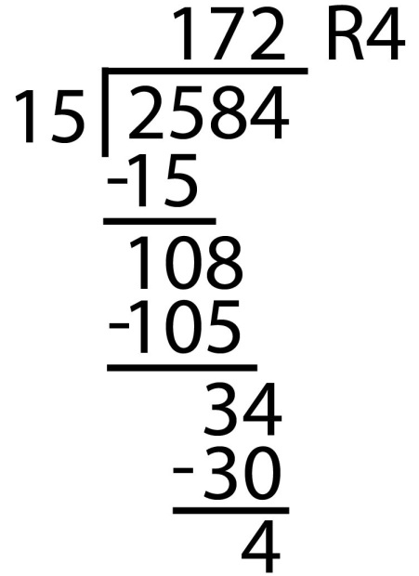
Dividers
A/B = Q + R/B
Decimal Example: 2584/15 = 172 R4
Long-Hand:

Slide 74
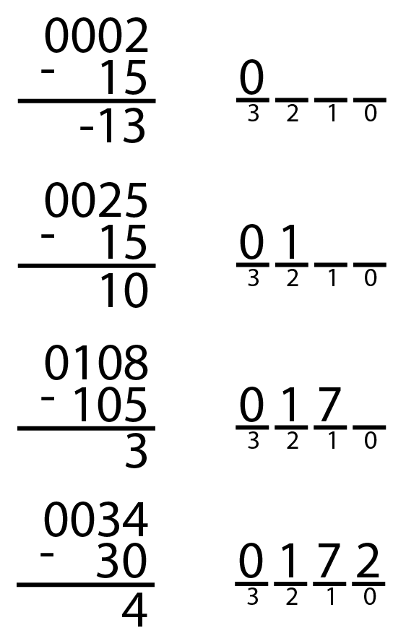
Dividers
A/B = Q + R/B
Decimal Example: 2584/15 = 172 R4
Long-Hand:
Long-Hand Revisited:

Slide 75
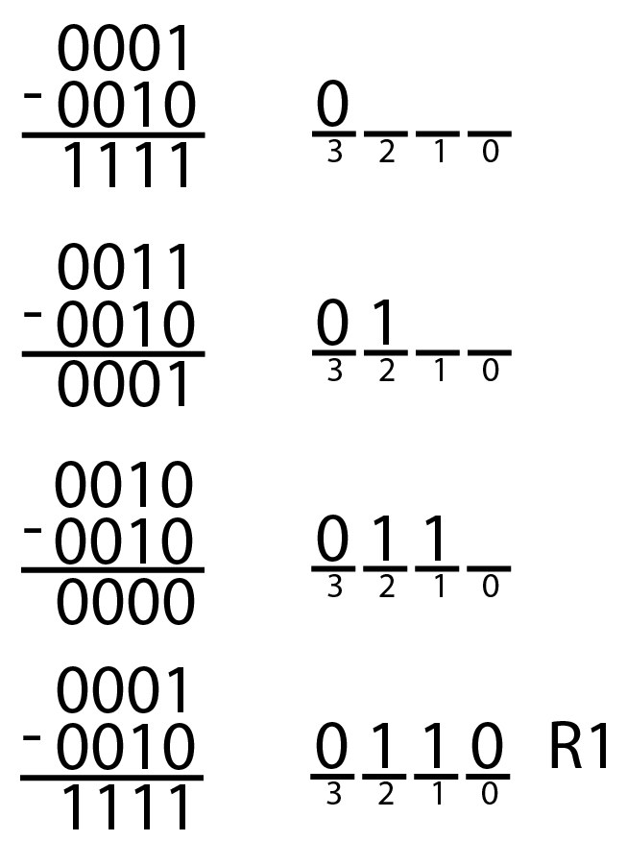
Dividers
A/B = Q + R/B
Decimal: 2584/15 = 172 R4
Binary: 1101/0010 = 0110 R1

Slide 76
Divider Algorithm
A/B = Q + R/B
R’ = 0
for i = N-1 to 0
R = {R’ << 1, A_{i}}
D = R - B
if D < 0, Q_{i}= 0; R’= R
else Q_{i}= 1; R’= D
R=R’
Binary: 1101/10 = 0110 R1

Slide 77
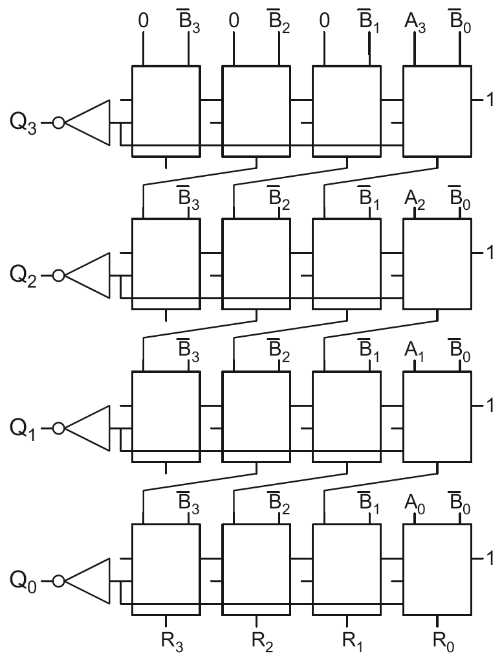
4 x 4 Divider
Division: A/B = Q + R/B
R’ = 0
for i = N-1 to 0
R = {R’ << 1, A_{i}}
D = R - B
if D < 0, Q_{i}=0, R’=R
else Q_{i}=1, R’=D
R=R’
Each row computes one iteration of the division algorithm.

Slide 78
4 x 4 Divider
Each row computes one iteration of the division algorithm.

Slide 79
4 x 4 Divider
Each row computes one iteration of the division algorithm.

Slide 80
4 x 4 Divider
Each row computes one iteration of the division algorithm.

Slide 81
4 x 4 Divider
Each row computes one iteration of the division algorithm.

Slide 82
4 x 4 Divider
Each row computes one iteration of the division algorithm.

Slide 83
4 x 4 Divider Ej.: 1101(A)/0010(B)
1
1
0
1
1
0
0
1
0
1
0
1
0
1
1
0
1
1
1
1
1
1
1
0
Division: A/B = Q + R/B
R’ = 0
for i = N-1 to 0
R = {R’ << 1, A_{i}}
D = R - B
if D < 0, Q_{i}=0, R’=R
else Q_{i}=1, R’=D
R=R’
0
1
0
1
1
0
0
1
1
1
1
1
1
0
0
1
0
1
0
0
1
1
0
0
0
1
0
1
1
1
1
1

Slide 84
Memory Arrays
Efficiently store large amounts of data
3 common types:
Dynamic random access memory (DRAM)
Static random access memory (SRAM)
Read only memory (ROM)
M-bit data value read/ written at each unique N-bit address

Slide 85
Memory Arrays
2-dimensional array of bit cells
Each bit cell stores one bit
N address bits and M data bits:
2^{N} rows and M columns
Depth: number of rows (number of words)
Width: number of columns (size of word)
Array size: depth × width = 2^{N} × M

Slide 86
Memory Array Example
2² × 3-bit array
Number of words: 4
Word size: 3-bits
For example, the 3-bit word stored at address 10 is 100

Slide 87
Memory Arrays

Slide 88
Types of Memory
Random access memory (RAM): volatile
Read only memory (ROM): nonvolatile

Slide 89
RAM: Random Access Memory
Volatile: loses its data when power off
Read and written quickly
Main memory in your computer is RAM (DRAM)
Historically called random access memory because any data word accessed as easily as any other (in contrast to sequential access memories such as a tape recorder)

Slide 90
ROM: Read Only Memory
Nonvolatile: retains data when power off
Read quickly, but writing is impossible or slow
Flash memory in cameras, thumb drives, and digital cameras are all ROMs
Historically called read only memory because ROMs were written at manufacturing time or by burning fuses. Once ROM was configured, it could not be written again. This is no longer the case for Flash memory and other types of ROMs.

Slide 91
Types of RAM
DRAM (Dynamic random access memory)
SRAM (Static random access memory)
Differ in how they store data:
DRAM uses a capacitor
SRAM uses cross-coupled inverters

Slide 92
Chapter 5
Digital Design and Computer Architecture: ARM® Edition
Sarah L. Harris and David Money Harris

